Slide 1
Introduction to philosophy Lecture 2
PHI1101
Dr. Lucas Scripter
Lecturer in General Education
School of Humanities and Social Sciences
Chinese University of Hong Kong, Shenzhen

Slide 2
Three ways of conceiving of philosophy
Philosophy as a Way of Life
Philosophy as the Foundation of the Sciences
Philosophy as Conceptual Analysis

Slide 3
Philosophy as a way of life

Slide 4


Philosophy as a way of life 1
Pierre Hadot’s idea of “philosophy as a way of life” includes four key aspects:
1. Goal of Philosophy:
Self-Transformation
2. Setting of Philosophy:
Practiced in a Group or School
3. Psychological Assumption:
Philosophical training can lead to a change in human beings.
4. Metaphysical Context:
Philosophers should cultivate ‘cosmic consciousness’

Slide 5
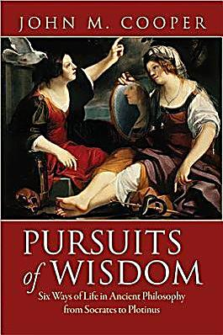
Philosophy as way of life 2
John M. Cooper (2012) has also argued that ancient philosophy is best understood as a ‘way of life’, but he emphasizes something different than Hadot.
“To live a life of philosophy is to live committed to following philosophical reason wherever it may lead. The promise is that by doing so—but only by doing so—one will achieve the best possible human life” (p. 18)
5. Living according to Reason
Conducing one’s life according to reason (not custom or religion)

Slide 6
Philosophy before socrates
(See esp. Gutherie, ch. 2-4)

Slide 7
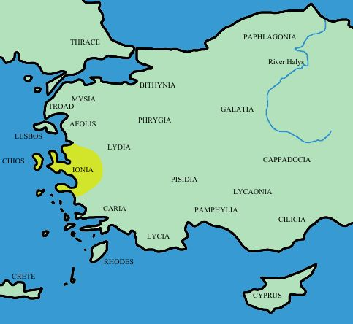
The ionian philosophers
The Ionian philosophers wrote in the 6th century BCE on the coast of Asia minor (present day Turkey).
The focus of their philosophy was on the nature of the world.
They represented a shift away from mythical explanations toward rational explanations in terms of substances (rather than gods).

Slide 8
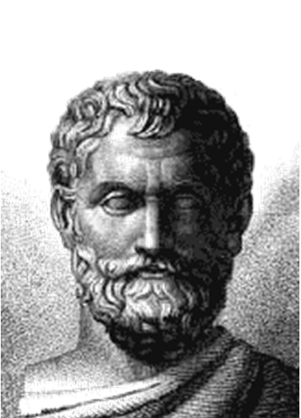
Thales of miletus
Thales of Miletus (624-546 BCE)
One of the major Ionian philosophers.
Claimed the fundamental substance composing the world was water or moisture.
Successfully predicted a solar eclipse in 585 BCE.
Said to have died by tragically falling into a well.

Slide 9
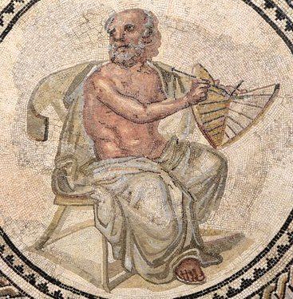
Anaximander
Anaximander (610-546 BCE)
One of the major Ionian philosophers
Argued that the world was a struggle between opposing properties (dry/wet, hot/cold).
Origin of the world was an apeiron (‘no boundary or limit’) or a moving mass that was not yet separated into various components things. Eventually things became differentiated.
Held that nothing props up the earth but that it was at the center of the world.

Slide 10
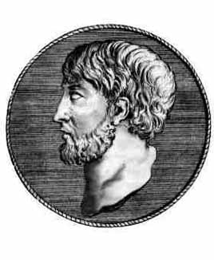
Anaximenes of miletus
Anaximenes (585-528 BCE)
Major Ionian philosopher following Thales and Anaximander.
He argued that the fundamental substance composing the world was air or mist ranging from imperceptible mist to condensed physical things or objects visible to the human eye.
Human soul consists of especially hot air.

Slide 11
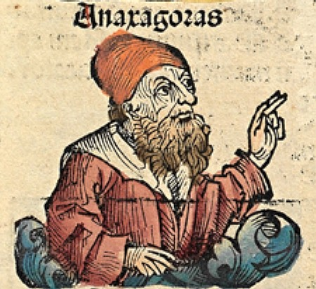
Anaxagoras
Early Greek scientific philosopher (510-428 BCE)
Charged with impiety (atheism) for claiming that the sun wasn’t a god but rather just a hot rock.
He was exiled from Athens.
His theory distinguished mind from matter and attributed mind as an organizing force behind a pre-existing matter.
Criticized for appealing to ‘mind’ only to fill in explanatory gaps in his material account.

Slide 12
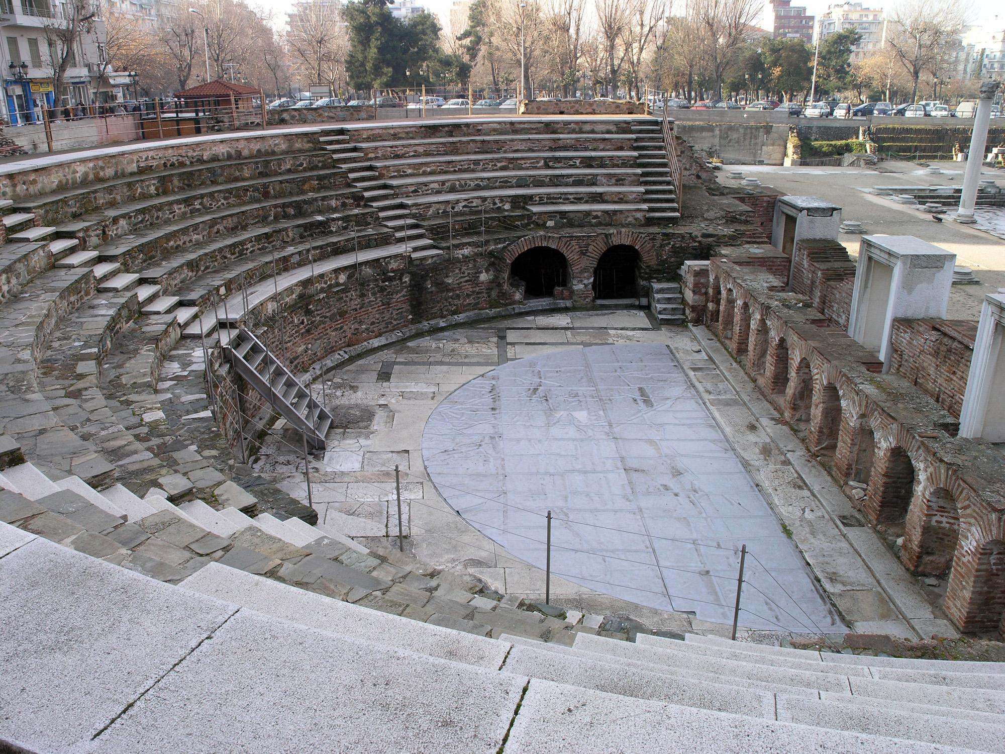
The sophists
The sophists were a professional class of traveling teachers that taught practical skills, above all rhetoric, for a price.
Some of the major sophists appear as figures in Platonic dialogues (e.g., Gorgias or Protagoras).
The Sophists concerns were practical and human-centered, marking a shift away from the concerns of the previous metaphysical-scientifically minded philosophers.

Slide 13
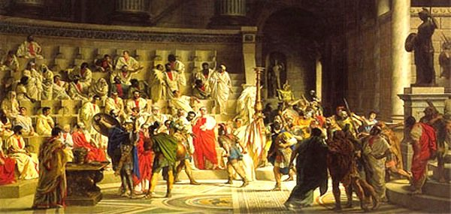
The sophists
The Sophists responded to a need for rhetorical training in Athenian democracy. They taught people persuasive skills, so they could achieve wealth, fame, and influence in the public square.
The Sophists taught the ability to make ‘the weaker arguments appear stronger’, i.e., the ability to influence an audience of whatever claim, regardless of its truth-value.
The Sophists taught a formal technique that could be applied to any subject matter:
“For the spirit of their teaching required that they should have no doctrine of their own, but should show how all doctrines could be defended, the most paradoxical and outrageous no less than those most commonly accepted…” (Robin, p. 142)

Slide 14
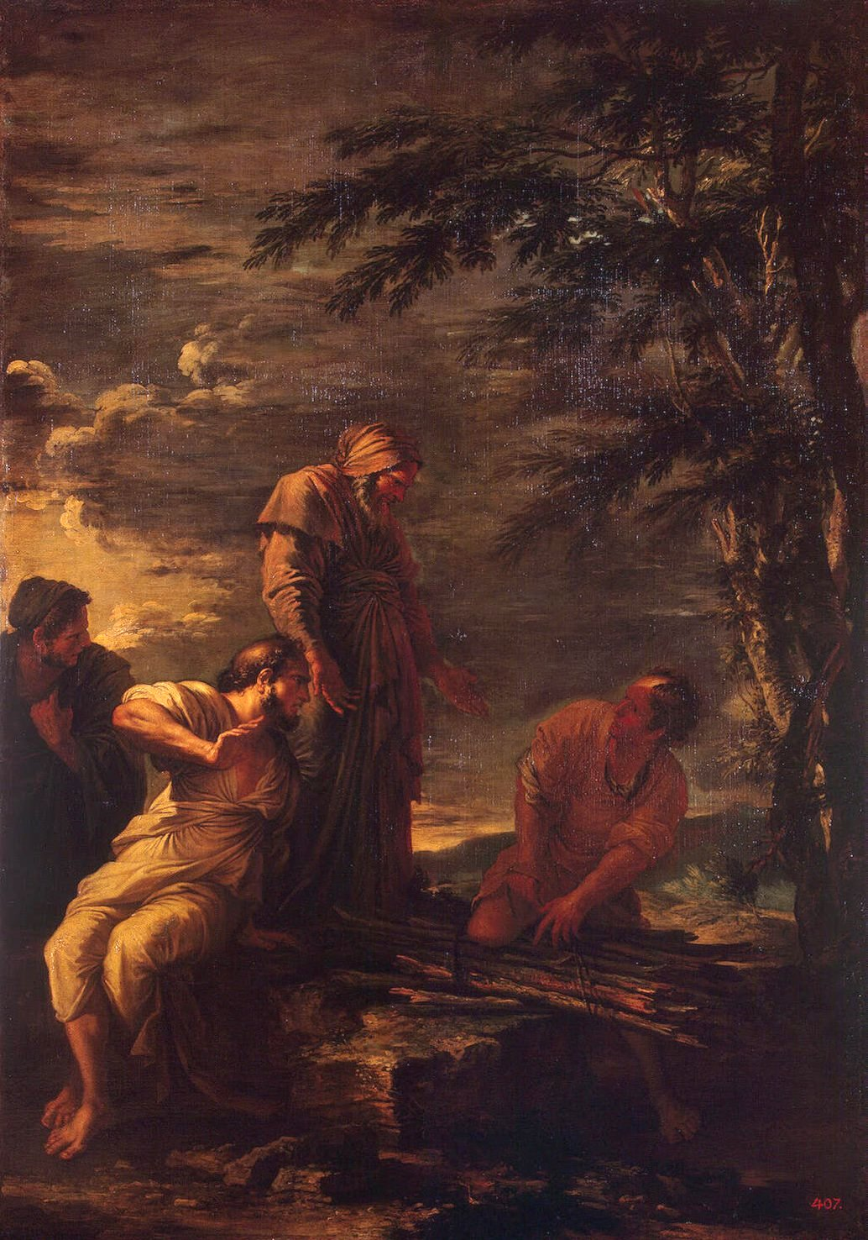
protagoras
Famous Sophist (490-420 BCE) who was also portrayed in the Platonic dialogue that bears his name.
Advanced a relativistic view of the world captured in his saying that “man is the measure of all things, of the being of those which are and of the not-being of those which are not” (quoted in Robin, p. 145).
He offered an early pragmatic account of how some representations could be more useful than others, even if not truer.
In his account of society, he developed an early version of the social contract.

Slide 15
Philosophy before Socrates as a way of life?
Pre-Socratics
The pre-Socratic philosophers didn’t view philosophy as a way of life but rather a way of investigating the nature of the world.
Aim of philosophy is centered on the natural rather than the human: to understand the constitution of the world, not bring about self-transformation.
Priority of Reason: reason rather than myth is used to explain the world, although not to guide one’s life.
Sophists
The Sophists did not practice philosophy as a way of life. Rather they offered to teach a skill for persuading others.
Not Truth-centered: Rhetoric (rather than philosophy) did not pursue the truth, but rather taught a skill to convince others.
No Self-transformation: The Sophists didn’t pursue transformation but rather the instrumental use o speech to pursue existing goals.

Slide 16
Socrates & plato

Slide 17
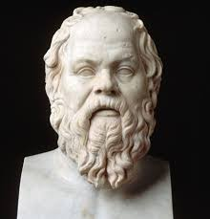
Who is Socrates?
Teacher of Plato
Most schools after Socrates (Platonism, Stoicism, Epicureanism, Cynicism, Skepticism) claim him as their founder.
Socrates himself didn’t write anything. We know about him through authors like Plato and Xenophon.
Aristophanes mocks Socrates by portraying him badly in The Clouds.

Slide 18
Plato’s dialogues
Early Dialogues
“Socratic” dialogues
Topic: Virtue
Middle Dialogues
Socrates is Plato’s mouthpiece
Topic: Virtue
Late Dialogues
Socrates not always the main character
Topic: focus is often on metaphysics or epistemology
No positive answers
Positive answers are given (Plato’s theory of forms etc.)

Slide 19
Philosophy in the symposium

Slide 20
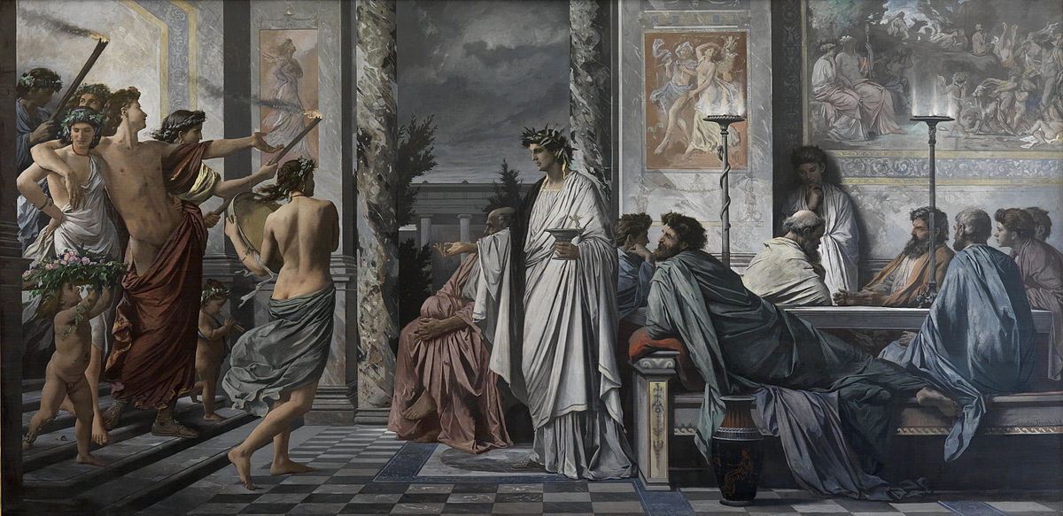
The symposium (a brief recap from GFH)
In Plato's Symposium, various notable figures gather to celebrate Agathon’s recent victory.
The members of the drinking party give speeches in praise of eros culminating in Socrates’s own speech about the nature of eros and philosophy.
A drunken Alcibiades joins the party late and delivers a speech in praise of Socrates.

Slide 21
Socratic elenchus 1 (Refutation of agathon)
A: Eros is the most beautiful of the gods.
S: Do we love something or nothing when we love?
A: We love something.
S: When we love something, do we desire it?
A: Yes, Socrates, we desire what we love.
S: When we desire something do we have it or lack it?
A: We lack it.
S: So when we love something, we desire what we don’t have.
A: Yes, that’s right.
S: what does eros desire?
A: the beautiful, obviously.
S: So if eros desires what it lacks and eros desires the beautiful, then it must not be beautiful.
A: Yes…I didn’t know what I was talking about.

Slide 22

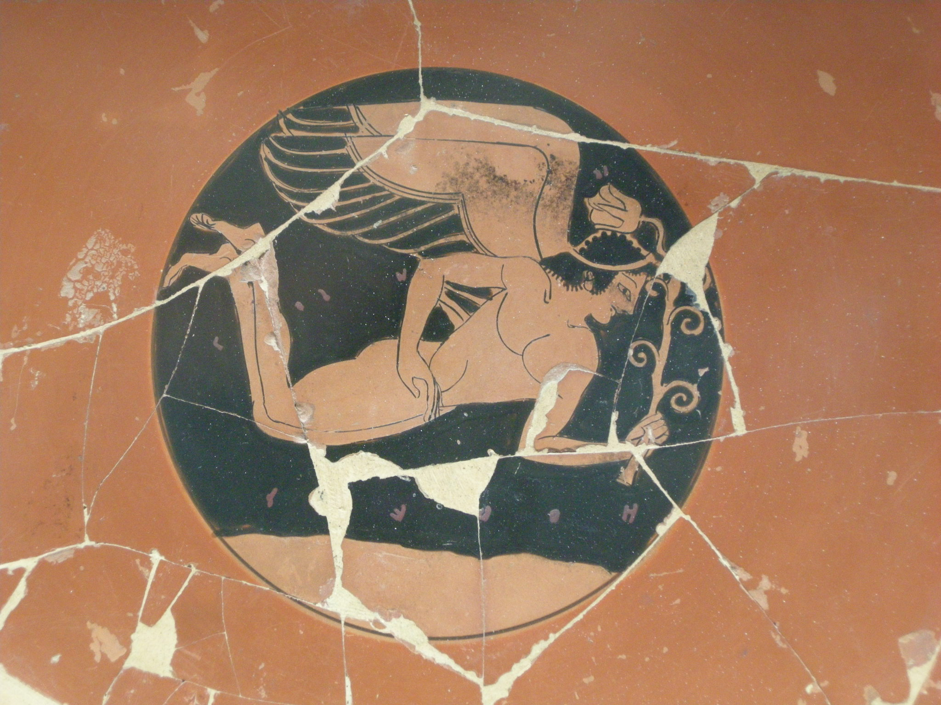


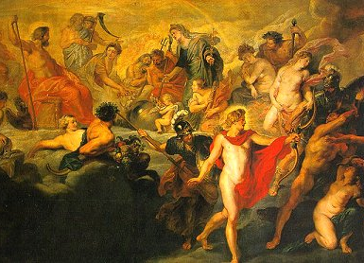
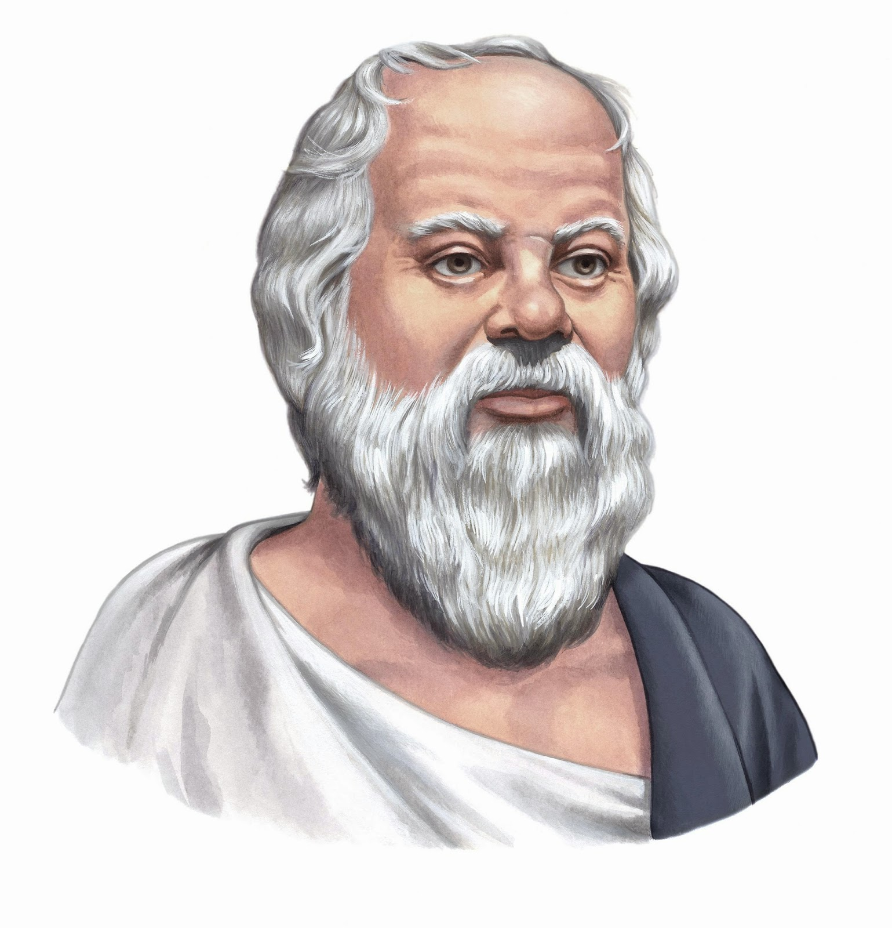
Eros & philosophy in the symposium
The Ugly
The Beautiful
The Ignorant
The Wise

Slide 23
the apology

Slide 24
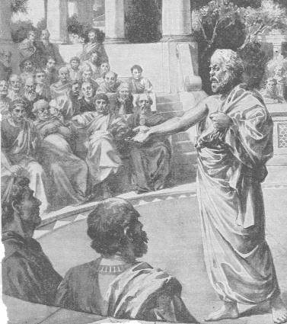
Accusations Against socrates
The Apology opens with Socrates standing trial.
The official charges brought against Socrates: impiety & corrupting the youth.
“Socrates is committing an injustice, in that he inquires into things below the earth and in the sky, and makes the weaker argument defeat the stronger, and teaches others to follow his example.” (Apology 19b-c)

Slide 25
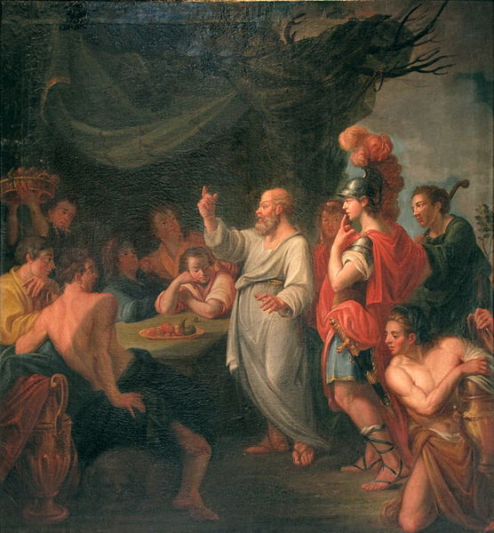
Socrates’s rebuttal
Socrates denies the charges brought against him.
Speaking of researches into nature, he says “I take no interest in these things.” (Apology 19d).
Unlike the Sophists, Socrates says he doesn’t take students for a fee but rather the young wealthy follow him around because they enjoy watching him question people.

Slide 26
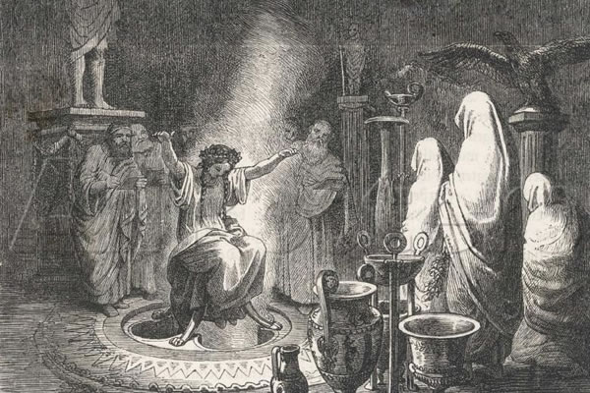
Origin of attacks on Socrates
Socrates explains a mysterious puzzle: that the Oracle at Delphi said he was the wisest man.
Socrates describes a divine quest to solve this riddle—one that led him to examine the wisest people in Athens (politicians, poets, and craftsmen).
He discovered that those who claimed to be wise, were not wise. He was the wisest because he didn’t’ claim to be wise.

Slide 27
Socratic elenchus II (Refutation of Meletus—Apology 24c-25c)
M: Socrates is guilty of corrupting the youth.
S: Who influences the young for the good?
M: The laws.
S: Which persons, specifically?
M: The members of the jury.
S: All of them?
M: Yes, all of them.
S: And the members of the council?
M: Of course.
S: And the members of the assembly?
M: Yes, indeed.
S: So the whole population of Athens except for me?
M: Yes, you alone corrupt the youth.
S: And what about with horses? Is it just one person who trains horses or everyone? Isn’t it that horse-trainers make horses good when others can’t. If this is so for horses, then surely it would also apply to humans and other animals. The young would be really lucky if all were a good influence on them except one. Truly, Meletus, you haven’t given this much thought.

Slide 28
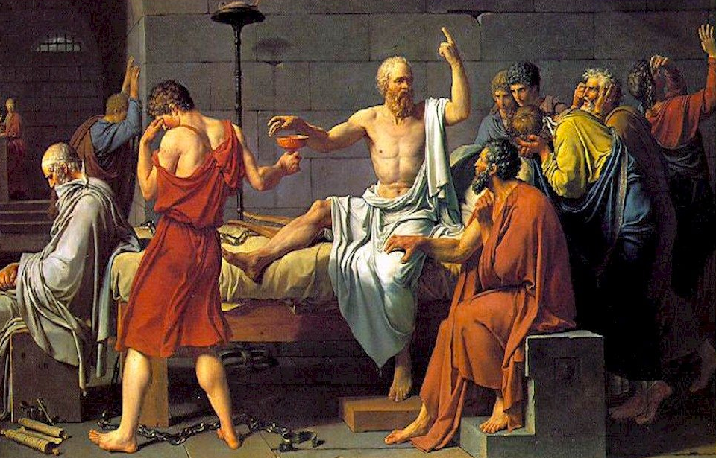
Socrates’ view of death
Socrates argues that acting wrongly—not death—is the true evil to be avoided.
“You are mistaken, my friend, if you think that a man who is worth anything ought to spend his time weighing up the prospects of life and death. He has only one thing to consider in performing any action; that is, whether he is acting justly or unjustly, like a good man or a bad one.” (Apology 28b-c)
“to be afraid of death is only another form of thinking one is wise when one is not; it is to think that one know what one does not know. No one knows with regard to death whether it is not really the greatest blessing that can happen to a man…But I do know that to do wrong and to disobey my superior, whether god or man, is bad and dishonorable.” (Apology 29a)
“the difficulty is not so much to escape death; the real difficulty is to escape from wickedness, which is far more fleet of foot.” (Apology 39b)

Slide 29
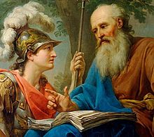
What concerns Socrates?
“Are you not ashamed that you give your attention to acquiring as much money as possible, and similarly with reputation and honour, and give no attention or thought to truth and understanding and the perfection of your soul?” (Apology 29d-e, italics mine)
“I spend all my time going about trying to persuade you, young and old, to make your first and chief concern not for your bodies or for your possessions, but for the highest welfare of your souls…” (Apology 30d, italics mine)

Slide 30
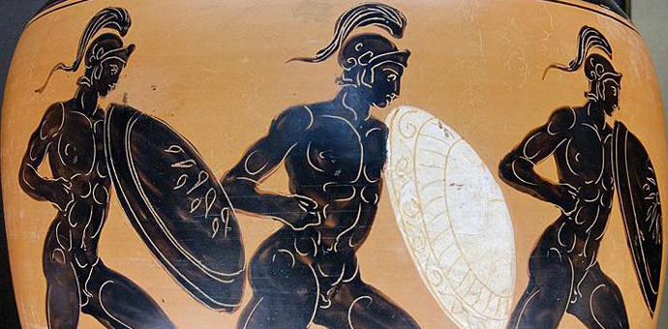
The sentencing of socrates
Upon receiving a ‘guilty’ verdict, Socrates is given the opportunity to plead his case for an appropriate punishment. His students are willing to put up a hefty some of money as a fine.
He argues that his good work in promoting moral improvement deserves to be taken care of by the city like an Olympic victor.
“I set myself to do you individually in private what I hold to be the greatest possible service: I tried to persuade each one of you not to think more of practical advantages than of his mental and moral well-being, or in general to think more of advantage than of well-being…So if I am to suggest an appropriate penalty which is strictly in accordance with justice, I suggest free maintenance by the State.” (Apology 36-37a)
The jurors failed to be convinced by this argument.

Slide 31
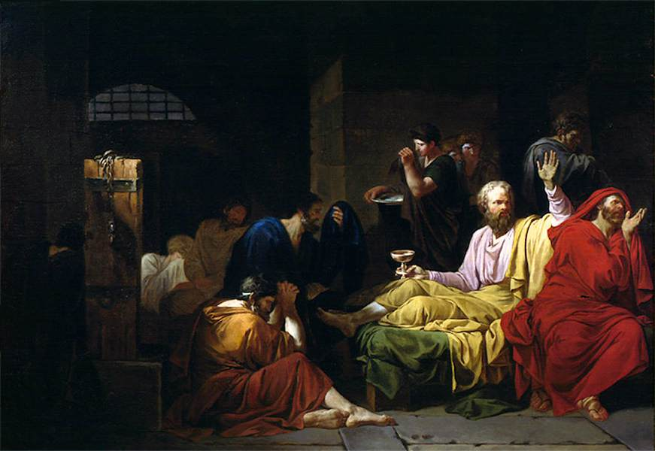
Socrates’s argument against fearing death
P1. Death is either annihilation OR it is a change to the afterlife.
P2. If we are annihilated, death isn’t an evil because its like a deep, pleasant sleep.
P3. If it is a change to the afterlife, death isn’t an evil because it’s a chance to converse with the famous dead.
C. Death isn’t an evil.
Socrates’s parting words: “nothing can harm a good man either in life or after death,
And his fortunes are not a matter of indifference to the gods.” (Apology 41c)

Slide 32
The crito

Slide 33
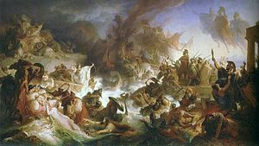
The setting
Socrates awaits death sentence was delayed because until the ships return from their annual voyage to Delos.
Socrates’s student Crito visits him in prison shortly before the boats are due back and attempts to convince him to escape.

Slide 34
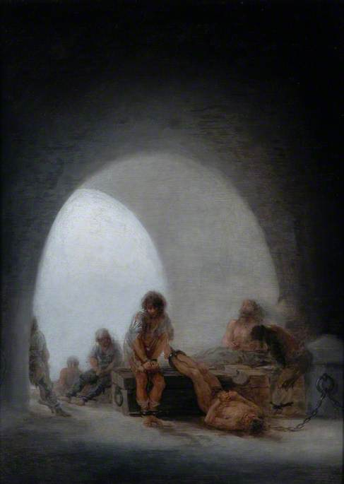
Crito’s proposal
Crito offers several reasons why Socrates ought to escape:
it would make his friends look bad;
it would be unjust because he would abandon his children;
there is money available to bribe the guards etc.

Slide 35
Socrates’ response to crito
Socrates convinces Crito that they should think through his suggestions and decided based on reason if they are good reasons.
Socrates says, “the really important thing is not to live, but to live well…And is it still agreed that to live well amounts to the same thing as to live honorably and justly?” (Crito 48b)
“to commit injustice is in every case bad and dishonorable for the person who does it.” (Crito 49b)
In following the state, is Socrates following a just agreement?
Socrates imagines a conversation between him and the Laws of Athens.
He argues that not following the laws is tantamount to destroying them and the state.
He argues that he owes something to the city for his upbringing.
He also argues that he had many chances to leave the city, if unhappy with the laws, but didn’t.
He also points out that he didn’t propose banishment at his trial.

Slide 36
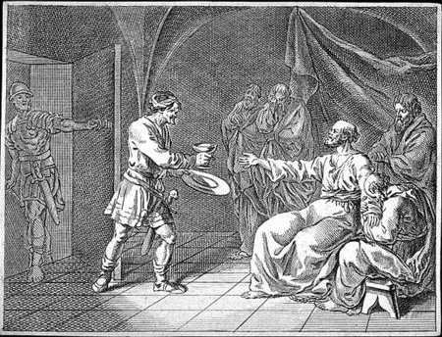
Socrates’ death
Socrates ends the Crito with an appeal to integrity. To try to flee from the prison would be to taint everything he did in his life.
“What subjects will you discuss, Socrates? The same s here, when you said that goodness and justice, institutions and laws, are the most precious possessions of mankind? Do you not think that Socrates and everything about him will appear in a disreputable light?” (Crito 53c-d).
“…and where will your discussions about justice and other good qualities be then, we should like to know?” (Crito 54a)

Slide 37
Socratic philosophy as a way of life?

Slide 38
Socratic philosophy as a way of life
Goal of Self-Transformation: Yes, Socrates focused on the investigation of virtue and moral topics. He stressed the overridingness of living justly.
Practiced in a Group: No, Socrates didn’t form a school, although he attracted followers. He did engage in philosophy, however, through dialogue with others. He also, as Hadot notes, lived and partook in city life—not the life of a recluse.
Ability to change: Yes, Socrates’s practice rested on the assumption that reflective dialogue can bring about a change and development of virtue.
Cosmic Consciousness: Yes and No, Socrates’s focus was clearly on the human life, yet he also showed respect for not overstepping the bounds of the human. He also showed a deference to the gods, if we take him seriously, when he described his mission.
(See discussions in Hadot 2004, ch. 3-4; Cooper, ch. 2)

Slide 39
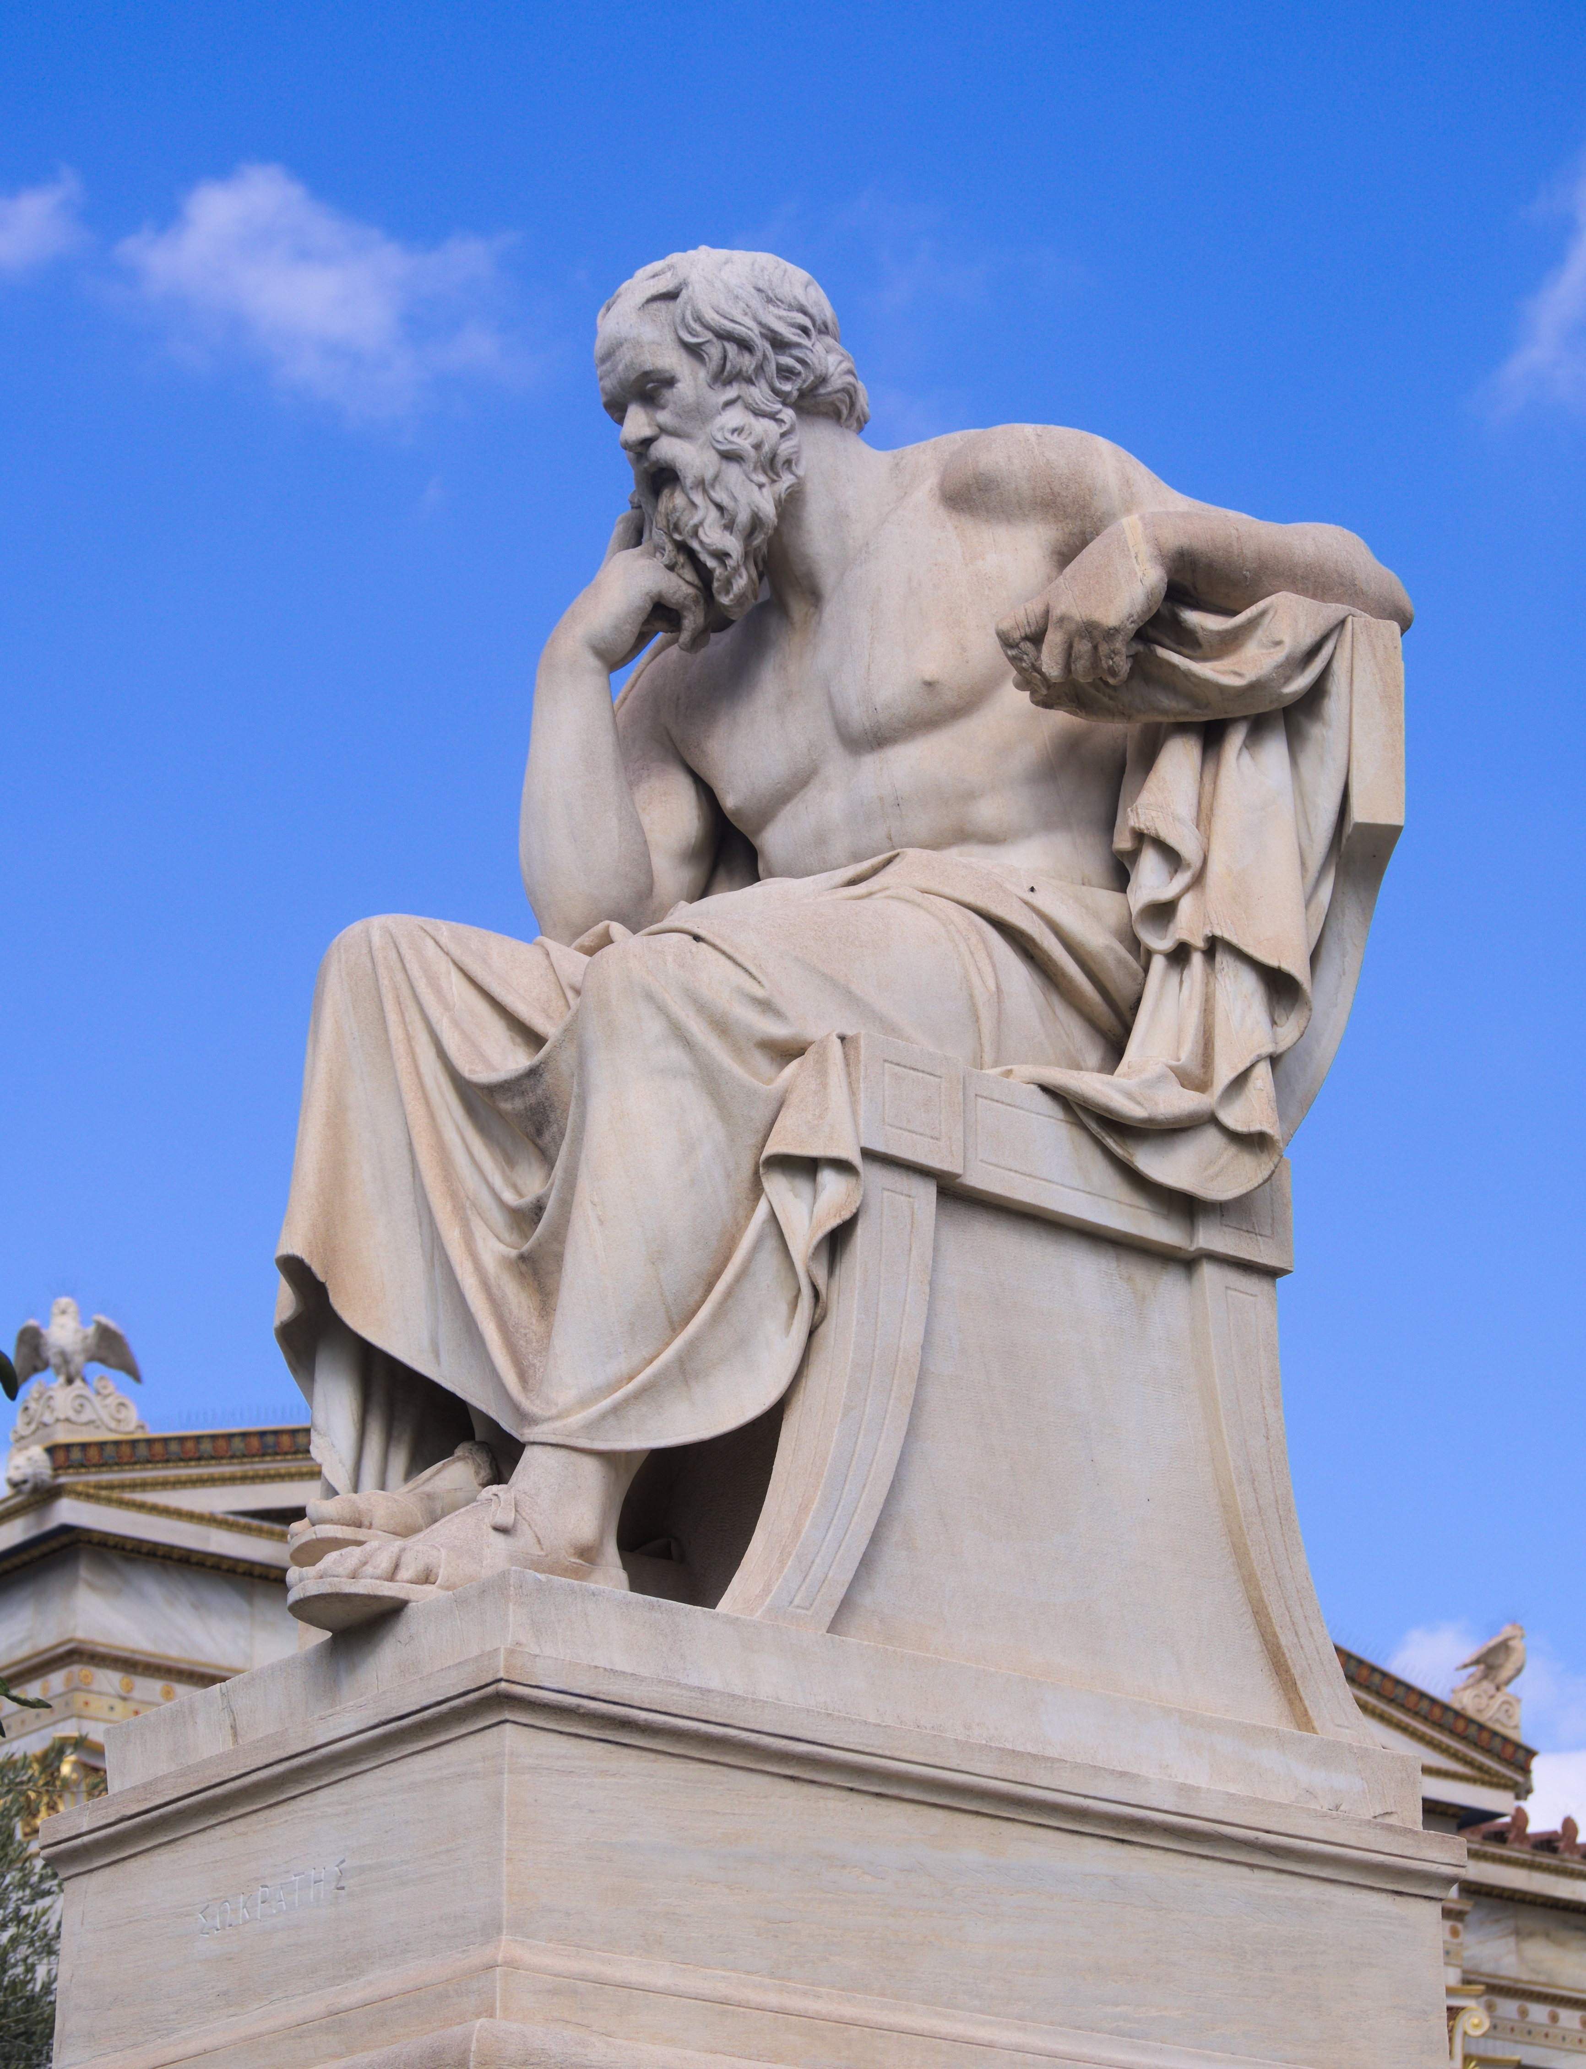
Socratic philosophy as a way of life
5. Living According to Reason: Socrates led a paradigmatic life of rational self-examination.
John Cooper argues that Socrates is the paradigm for philosophy as a way of life: “In this conception of philosophy involves a commitment to logical reasoning as the fundamental method for the formation of respectable beliefs” (Cooper, p. 30).
“Socrates’s passionate but tentative commitment to exploratory, open-ended philosophical reasoning as the grounding for the whole of ones life is unique to this one ancient way of life” (Cooper, p. 65)

Slide 40
Bibliography
Cooper (2012). Pursuits of Wisdom. Princeton.
Gutherie (1950). The Greek Philosophers: From Thales to Aristotle. Harper & Row.
Hadot (2004). What is Ancient Philosophy? Harvard UP.
Hadot (1998). Philosophy as a Way of Life. Blackwell.
Robin (1996). Greek Thought: And the Origins of the Scientific Spirit. Routledge.
Translations of Platonic Dialogues from The Last Days of Socrates (2003), translations by Hugh Tredennick and Harold Tarrant. Penguin.

